Slide 1

CSE3BDC/CSE5BDC
Big Data Management on the Cloud
Lecturer: Zhen He
Lecture 7

Slide 2
Jobs in Big Data
Survey from O’Reilly Strata conference of people working in the USA in the area of data science and big data.
You can get the survey report for free from here:
  http://www.oreilly.com/data/free/stratasurvey.csp?cmp=pe-strata-free-product-stny14_big_data_analytics_apr
The survey was mainly focused on the salary of the attendees as a function of what tools they used.

Slide 3
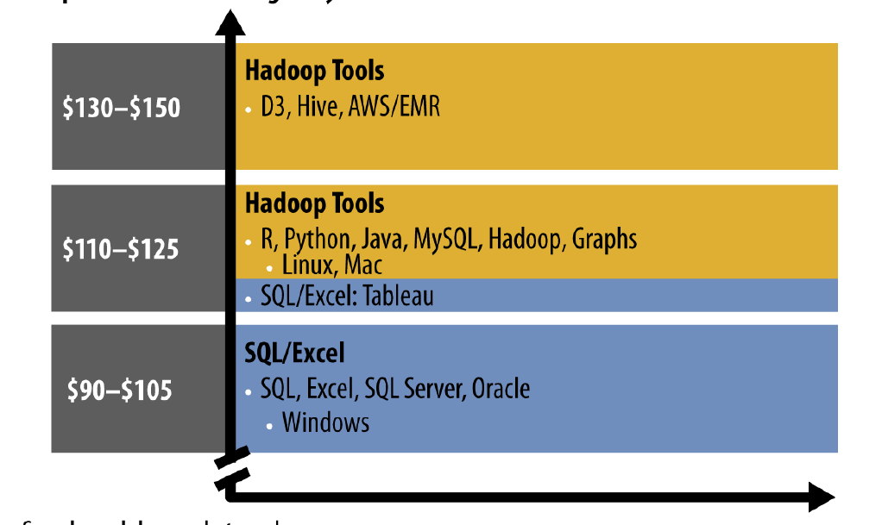
Jobs in Big Data
Median salary of attendees based on what tools they used.
Open source rocks!
  The tools in yellow are all open source
  The tools in blue are commercial tools.

Slide 4
Findings from Survey
SQL was used by most respondents (71% compared to next highest R at 43%)
Salaries positively correlated with the number of tools used
  Average of 10 tools earns: $100K
  Average of 15 tools earns: $130K
People who used the commercial tools used them in isolation whereas open source people used more tools together.
People who used open source tools earned more money
  Open source median salary: $130K
  Commercial median tools: $90K

Slide 5
Hadoop Ecosystem
What else is there in the open source Hadoop Ecosystem?
The tools in red font are the ones which we will cover in more detail.
Higher level programming abstractions
on top of MapReduce
  Pig
  Hive
  Mahout
Data Importing into HDFS
  Avro
  Sqoop
  Flume
Other tools
  Oozie
  ZooKeeper
NoSQL on Hadoop
  Hbase
Next Generation
  Interactive querying (based on Dremel)
    Impala
    Presto
    Search
  Yarn
    Storm
    Giraph
      Based on Pregal
  Berkley AmpLab
    Spark
    SparkSQL
    Spark streaming
    GraphFrames

Slide 6
Lecture Outline
Hadoop New Generation
  Spark Internals
  Programming Spark

Slide 7
Spark Internals

Slide 8
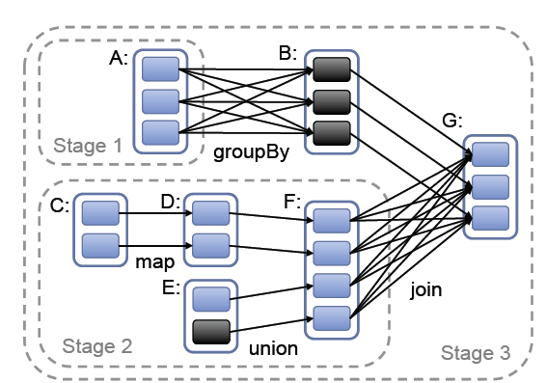
Representing RDDs
Spark builds a graph of the workflow.
Two key elements of the graph are
  A set of partitions which are atomic pieces of the data set
  A set of dependencies on parent RDDs

Slide 9
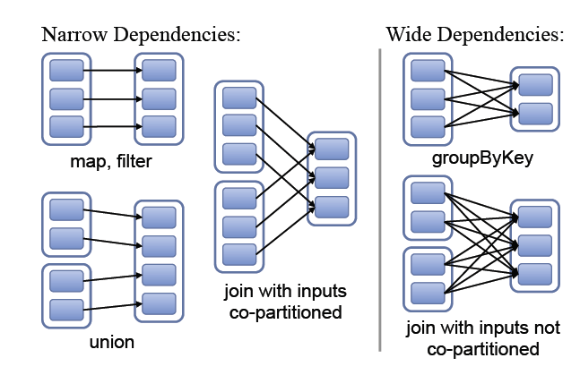
Classification of Dependencies
Spark classifies dependencies into two types
  Narrow Dependencies
    Where each partition of the parent RDD is used by at most one partition of the child RDD.
    Allows for pipelined execution on one cluster node.
      A sequence of operations involving narrow dependencies can be computed on the same node without any need for communication with any other node.
      Pipelining means the computations can happen in parallel without any node needing to wait for any other node.
      E.g. A map followed by a filter on an element-by-element basis

Slide 10
Classification of Dependencies
Wide dependencies
  Where multiple child partitions may depend on one partition
  For example groupByKey is a wide dependency since a child partition may need data from more than one parent partition.
  Wide dependencies do not allow for pipelining since they require data from all parent partition to be available to be shuffled across the nodes using a MapReduce like operation.

Slide 11
Impact of dependencies on Recovery
Narrow dependencies is more efficient for recovery since only the lost parent partitions need to be recomputed.
For wide dependencies a single failed child node might need some data from all the ancestors RDDs, requiring a complete re-execution.

Slide 12
Fault Tolerance
For wide dependencies
  To speed up recovery spark materializes intermediate records on the nodes that hold the parent partitions to simplify recovery.
    Similar to MapReduce materializing map outputs
If a task fails, spark re-run it on another node.

Slide 13
Job Scheduling
When an action is run on a RDD, the scheduler examines the RDD lineage graph to build a directed acyclic graph of stages (DAG) to execute.
Each stage contains as many pipelined transformations with narrow dependencies as possible.
The boundaries of the stages are the shuffle operations required for wide dependencies.
The scheduler always tries to move the computation to the data (where the RDD resides).

Slide 14
Job Scheduling
For the above example the map and union are all within the same stage (stage 2) because they do not contain any wide dependencies and therefore the operations within the stage can be pipelined.
It is interesting to note that going from RDD B to G is a narrow dependency because in the above example the groupBy key is the same as the join key.
  This means the data within in RDD B is already partitioned.
  The actual way this would be implemented is that the data in F will be shuffled to nodes that contained the partitioned B and joined on those nodes.
    This means that the data in B do not need to move across the network at all.

Slide 15
Checkpointing
Sometimes a job has many many steps.
  This creates very long lineage graphs.
If a node crashes there maybe a lot of work that needs to be redone
In order to speed up recovery, RDDs are checkpointed to stable storage.
In general checkpointing is most useful for wide dependencies and long lineage graphs.

Slide 16
Programming Spark

Slide 17
Learning Spark
Easiest way: the shell (spark-shell or pyspark)
  Special Scala / Python interpreters for cluster use
Runs in local mode on 1 core by default, but can control with MASTER environment var:
MASTER=local ./spark-shell # local, 1 thread
MASTER=local[2] ./spark-shell # local, 2 threads
MASTER=spark://host:port ./spark-shell # cluster
Look at the Spark API
  https://spark.incubator.apache.org/docs/latest/api/core/index.html#org.apache.spark.package
  Look at all the functions the RDD abstract class and PairRDDFunctions class

Slide 18
Best Current Documentation On Spark
Due to the fact Spark is so new, it is very hard to find examples of the API calls.
Matthias and I have create examples for almost all Spark RDD API calls.
  Altogether 110 Spark RDD API calls!
You can get it from here
  http://homepage.cs.latrobe.edu.au/zhe/ZhenHeSparkRDDAPIExamples.html

Slide 19
First Stop: SparkContext
Main entry point to Spark functionality
Created for you in Spark shells as variable sc
sc.hadoopRDD allows passing any Hadoop Configuration file to configure an input source

Slide 20
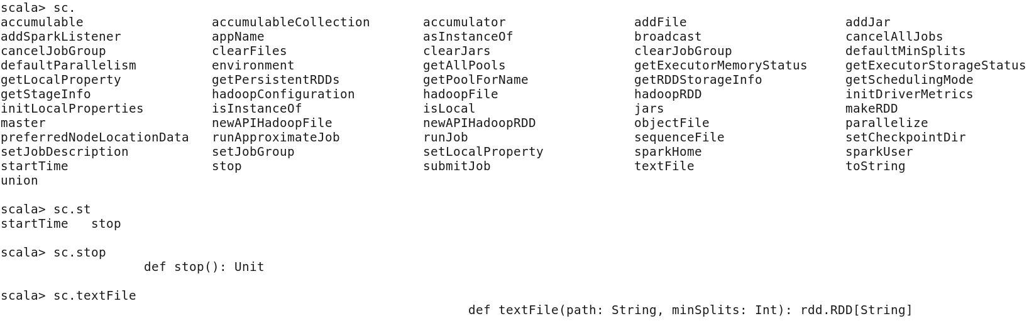
Tab completion
In spark you can use the <tab> key to get options for completing the statement.
See the examples below.
At the end of each of the statements below I pressed the <tab> key.

Slide 21
Creating RDDs
# Turn a local collection into an RDD
sc.parallelize([1, 2, 3])
or
val colors = List(“red”, “blue”, “green”)
sc.parallelize(colors)
# Load text file from local FS, HDFS, or S3
sc.textFile(“file.txt”)
sc.textFile(“directory/*.txt”)
sc.textFile(“hdfs://namenode:9000/path/file”)
# Use any existing Hadoop InputFormat
sc.hadoopFile(keyClass, valClass, inputFmt, conf)

Slide 22
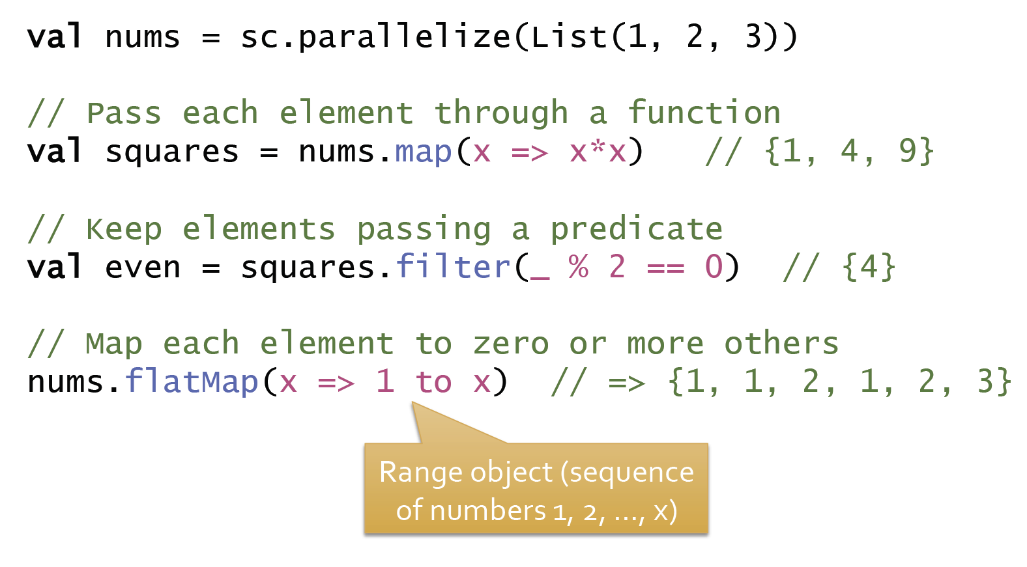
Basic Transformations
It is important to remember all these RDD transformation do not mutate the input RDD it just creates a new RDD which is populated with the updated data.

Slide 23
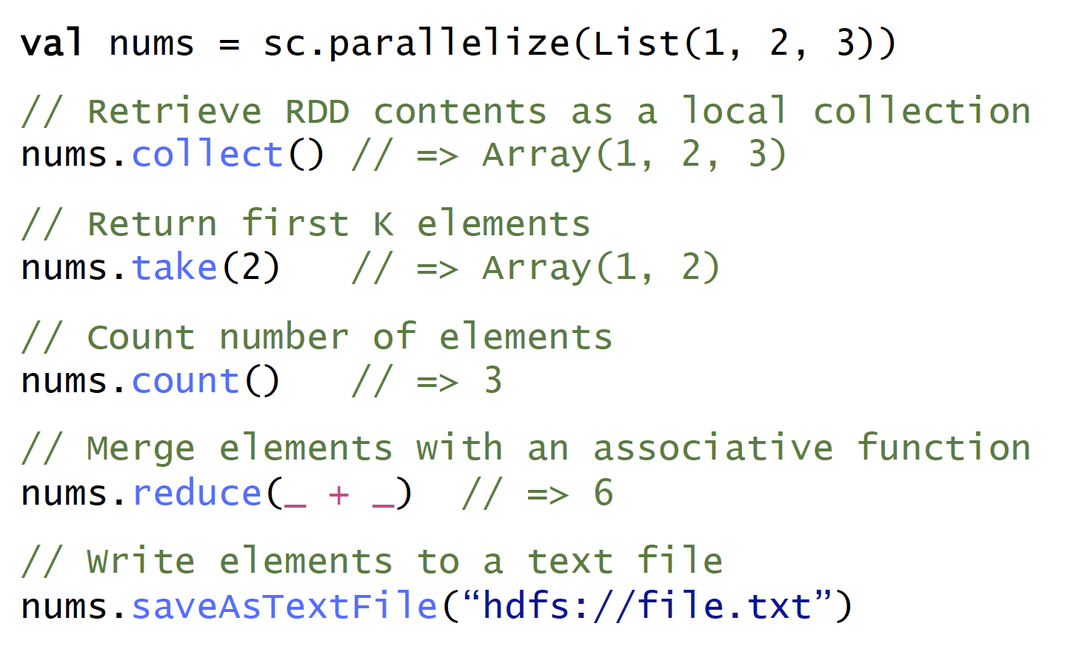
Basic Actions

Slide 24
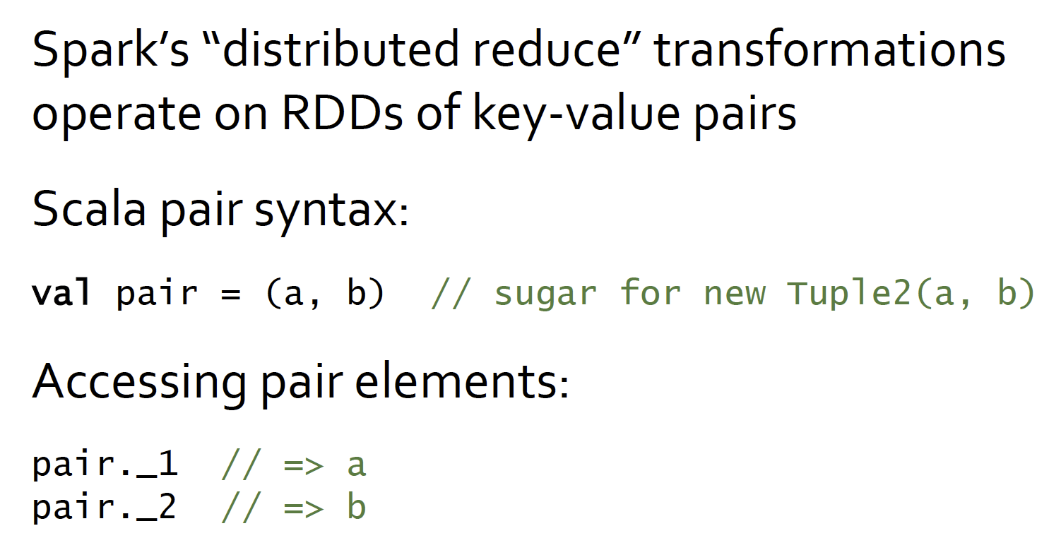
Working with Key-Value Pairs

Slide 25
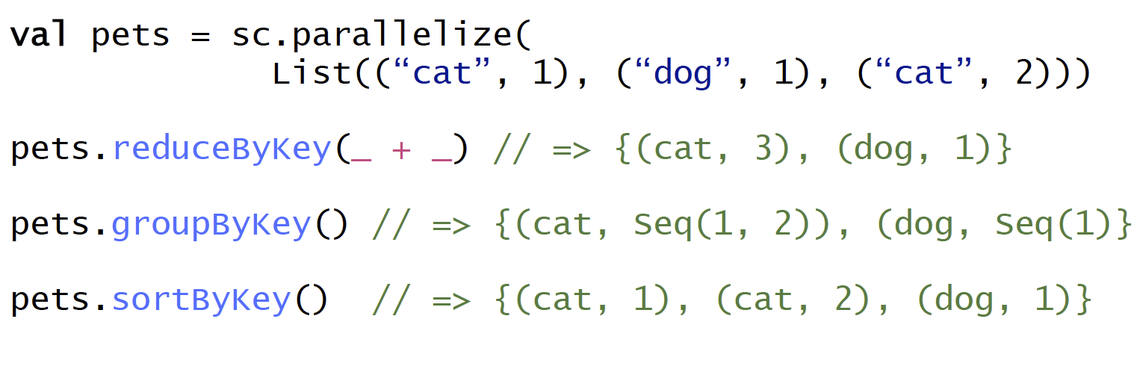
Some Key-Value Operations
I like the sortBy function better than sortByKey, since it gives you more flexibility.
pets.sortBy(x => x._1, true) // {(cat, 1), (cat, 2), (dog, 1)}
  Sorts by the first attribute, in ascending order
pets.sortBy(x => x._2, false) // {(cat, 2), (dog, 1), (cat, 1)}
    Sorts by the second attribute, in descending order

Slide 26
Combiners and local aggregation
In Spark functions like reduce, fold, reduceByKey, automatically have combiners implemented.
  Spark automatically applies the reduce function within the parent RDD.

Slide 27
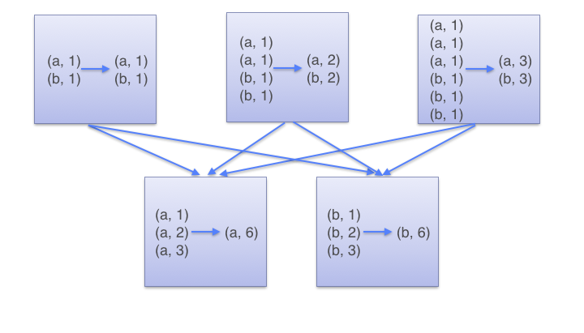
How does reduce by Key work?
reduceByKey(_ +_)
First adds up the number for each key within the local machine
mappers
Shuffles data based on key value
reducers
key b
key a
Finally sums up all values per key

Slide 28
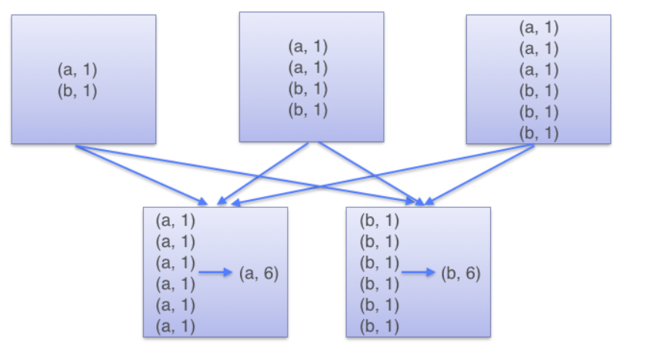

Group By Key
groupByKey()
mappers
reducers
Notice here all the data is shuffled and grouped at the reducer

Slide 29
Combiners and local aggregation
However, functions like reduce, fold, reduceByKey can only combine two inputs into one output.
What if our output has 2 elements instead of just 1?
  e.g. if we wanted to find the top 2 numbers within an RDD we can not use these functions.
We can sort all the numbers and then take the top two like
  Assume num is an RDD containing sequence of numbers
  num.sortBy(x=>x, false).take(2)
However, this results in a lot of data shuffling
How can we use a combiner for this situation?
  Use mapPartitions

Slide 30
mapPartitions versus map/reduce/reducebykey
The map/reduce/reducebykey functions only take one or pairs of input elements at a time.
RDD
9 2 1 2 1 4 1 4 9
Partition 1
Partition 2
Partition 3
The mapPartitions functions take all elements of a partition at a time as input. Thus it give you an opportunity to reduce the input from the entire partition before outputting the result.

Slide 31
mapPartitions
mapPartitions allows us to iterate through all the elements within a partition and output a different iterator containing any number of elements.
Using this we can find the top 2 within every parent partition and then only send 2 to the reducer
Using this we can perform local aggregation to reduce the amount of data shuffled. Below is the example code.
    def top2(iter: Iterator[Int]) : Iterator[Int] = {
    iter.toList.sortWith(_ > _).take(2).iterator
    }
    nums.mapPartitions(top2).collect.sortWith(_>_).take(2)
At the reducer the numbers from each of the parent RDD partitions are sorted and the top 2 returned.
  Due to the use of the local aggregation there should not be too much work left for the reducer to do.

Slide 32
Watch this for tips on optimizing performance
https://www.youtube.com/watch?v=NXp3oJHNM7E
Be careful the examples in the slides are in python.
The next two slides are from here. I have converted them into scala.

Slide 33
Avoid GroupByKey if possible
(patrick, $24), (matei, $30), (patrick, $1), (aaron, $23), (aaron, $2), (reynold, $10), (aaron, $10)…..
RDD
Copies all data over the network
spendPerUser = rdd
.groupByKey()
.map(pair => (pair._1, pair._2.reduce(_+_))
.collect()
spendPerUser = rdd
.reduceByKey(_+_)
.collect()
Using reduceByKey is much better
will do local aggregation
Reduces locally before shuffling

Slide 34
Large number of “empty” tasks due to selective filter
rdd = sc.textFile(“s3n://bucket/2013-data”)
.map(_.split(“\t”))
.filter(_(0) == “2013-10-17”)
.filter(_(1) == “19:00”)
rdd.map(parts => (parts(2), parts(3))).reduceBy…
Maybe data spread across 1000 partitions but only 2 contain the data we want.
The reduceBy will still run on the partitions which contain no data after the filtering.
Detecting Many short-lived (< 20ms) tasks
Fixing
Use `coalesce` or `repartition` operator to shrink RDD number of partitions after filtering:
rdd.coalesce(30).map(parts => (parts(2), parts(3))).reduceBy …

Slide 35
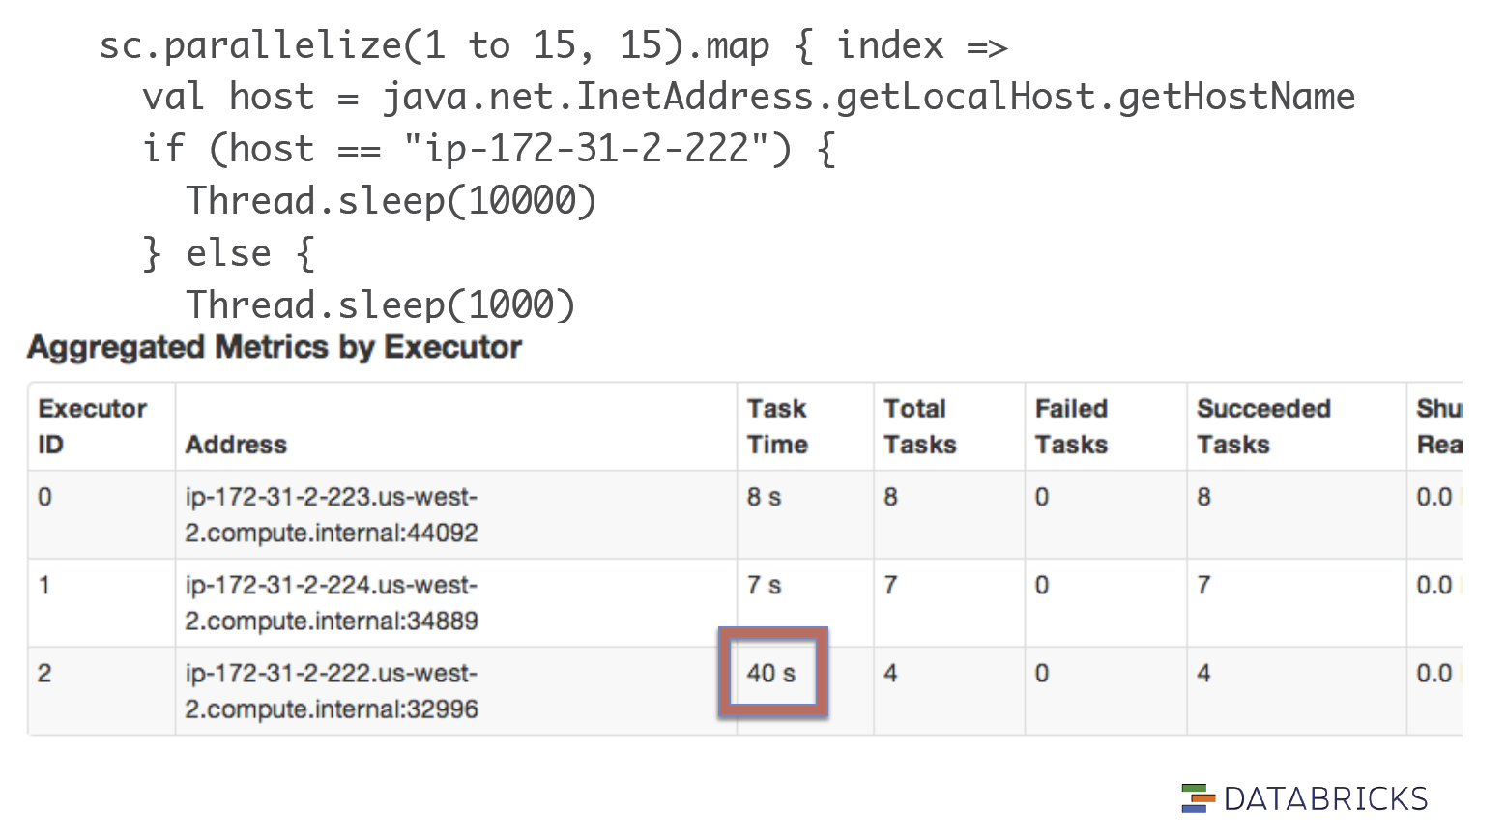
Stragglers due to slow nodes

Slide 36
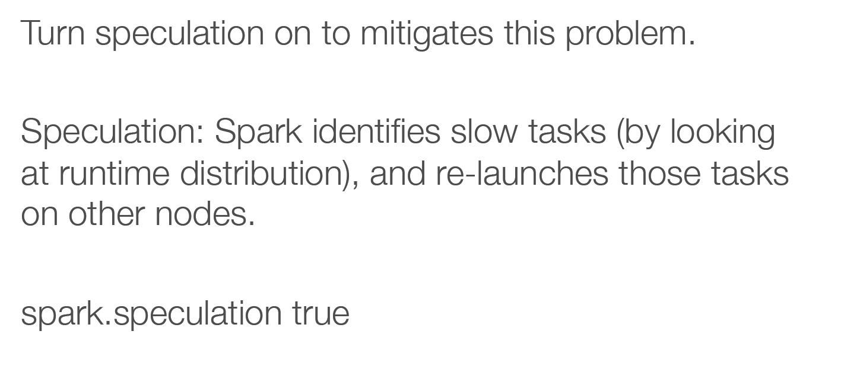
Stragglers due to slow nodes

Slide 37
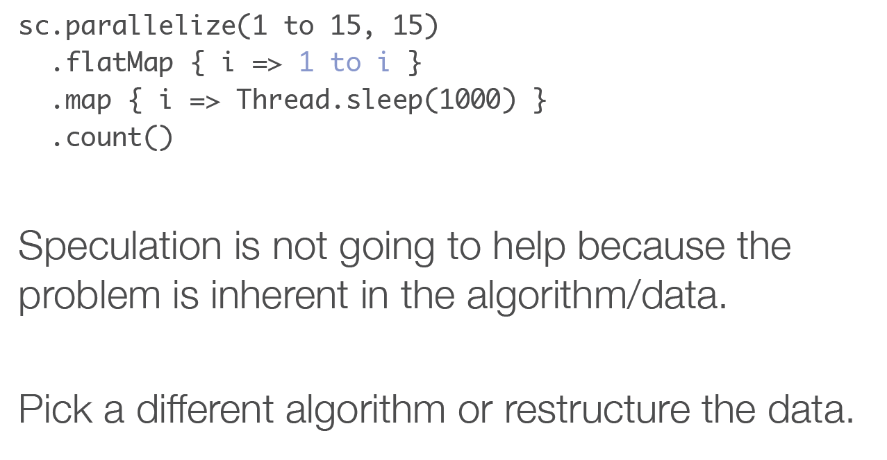
Stragglers due to data skew

Slide 38
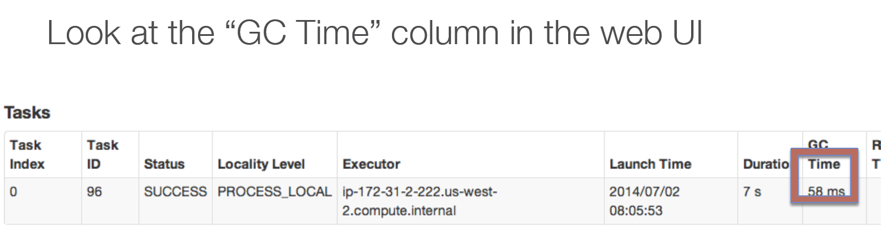
Garbage Collection

Slide 39
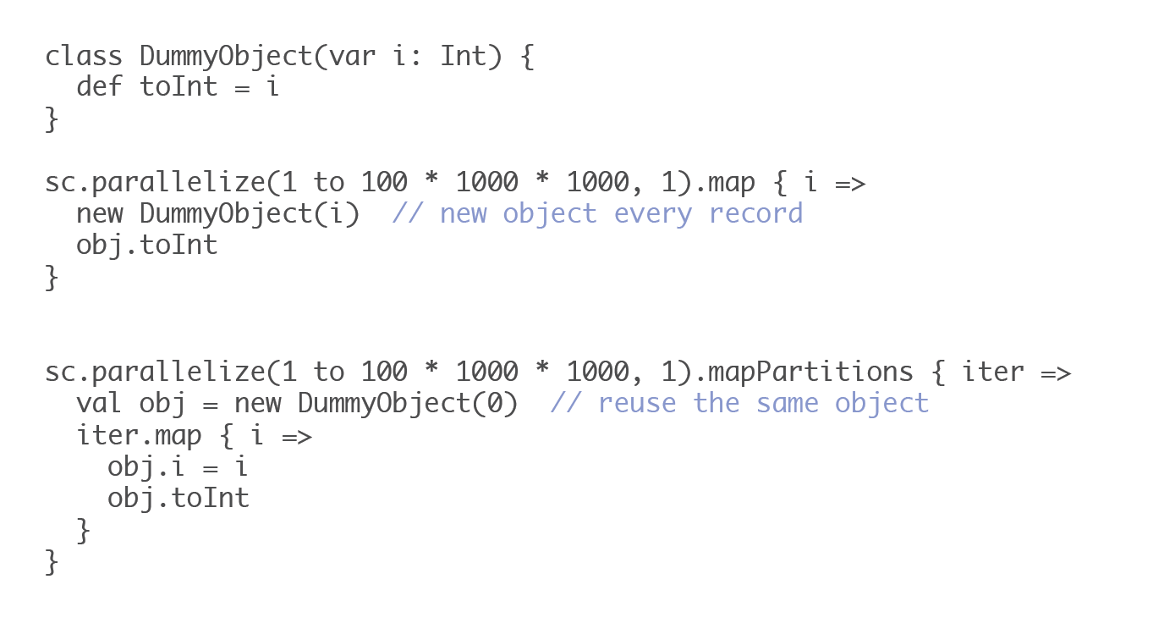
Reduce Garbage Collection Time

Slide 40
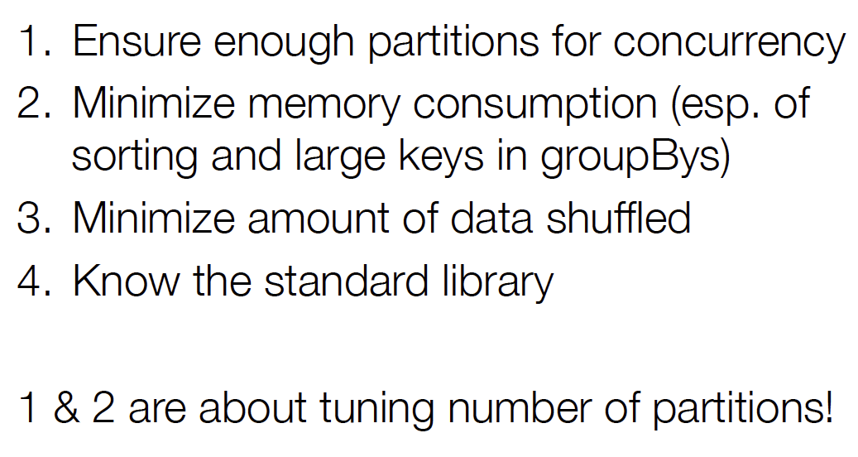
Common issue checklist

Slide 41
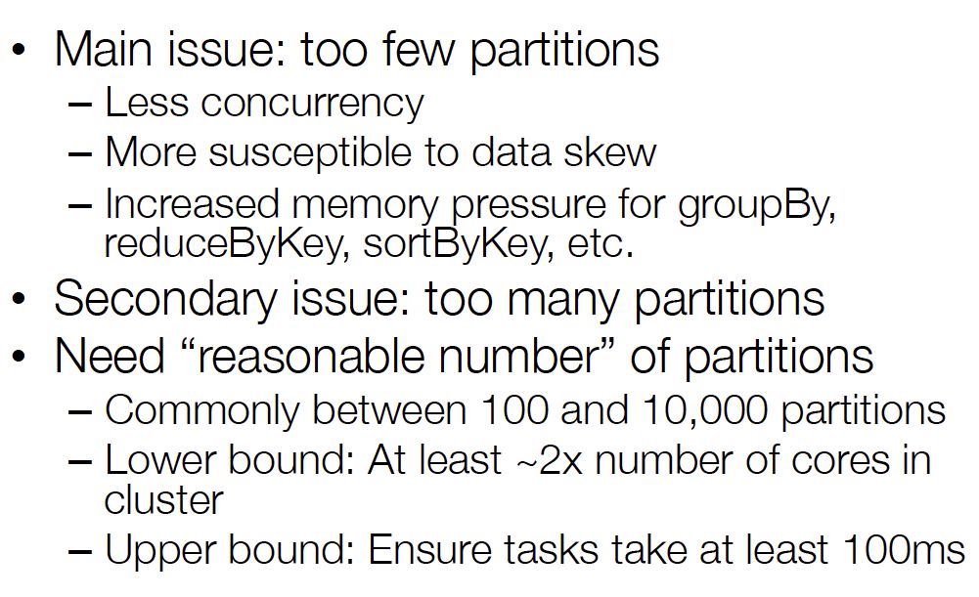
Importance of Partition Tuning
val x = sc.parallelize(List(1,2,3,4,5,6), 5)
Number of partitions

Slide 42
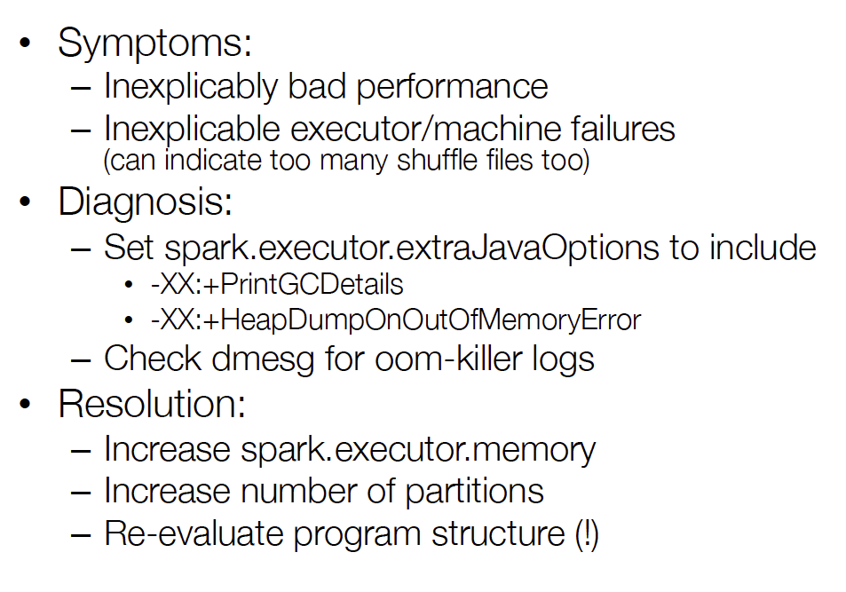
Memory Problems

Slide 43
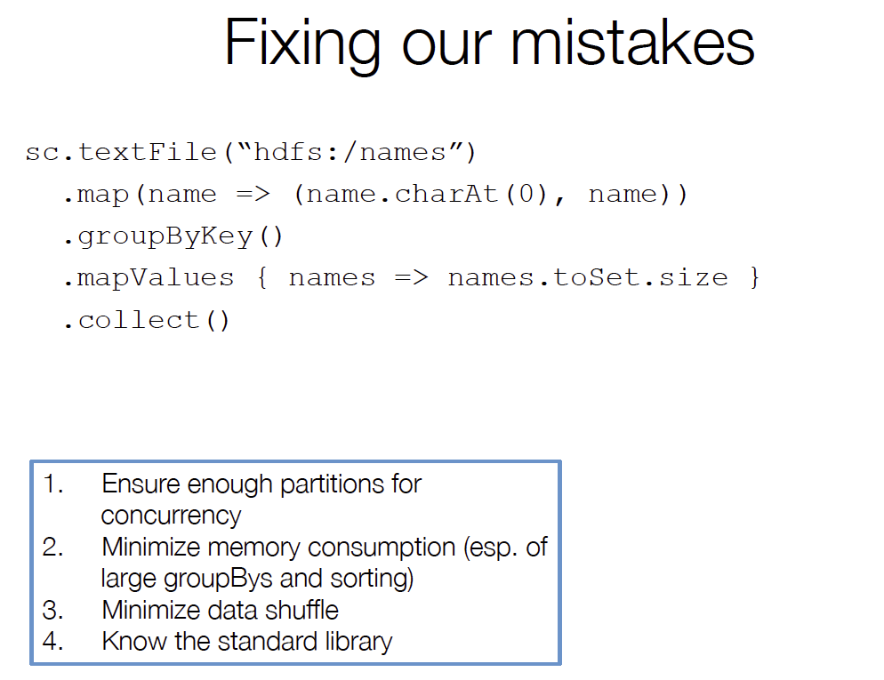

Slide 44
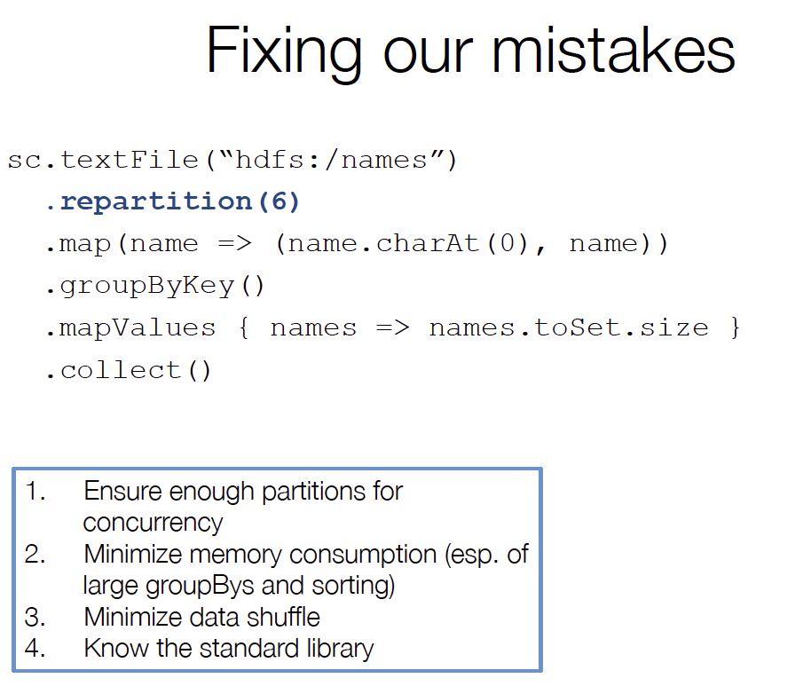

Slide 45
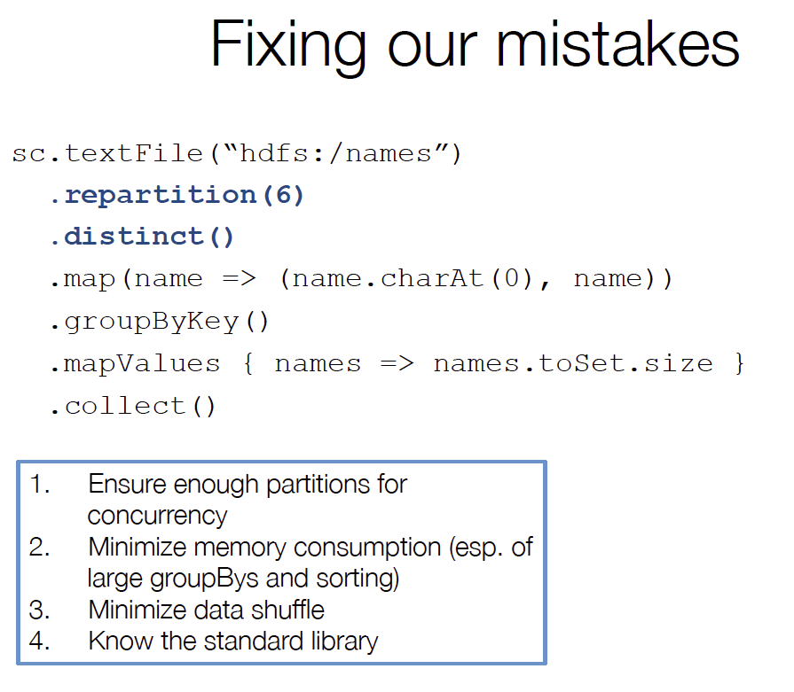

Slide 46
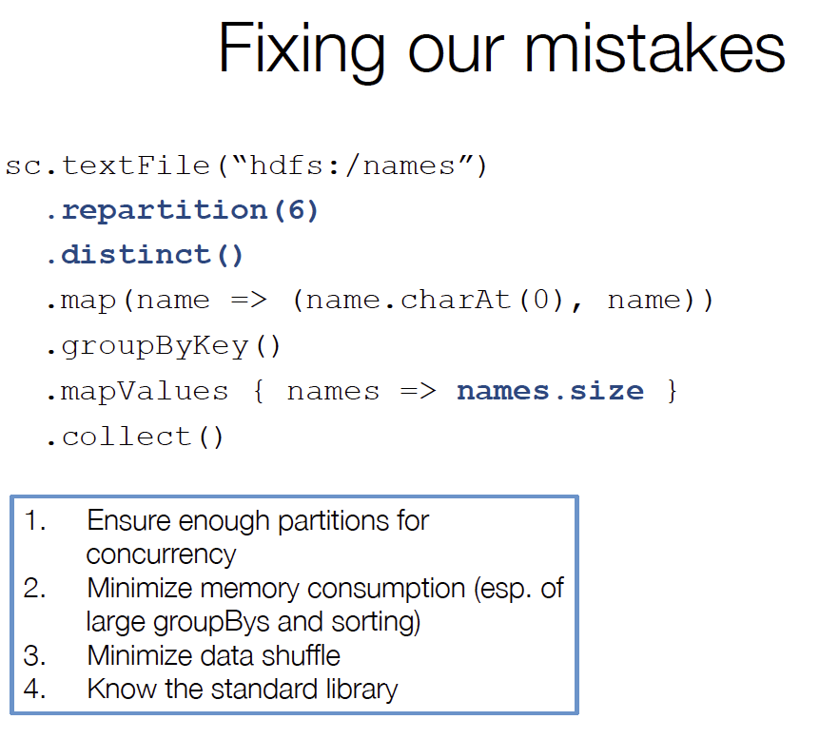

Slide 47
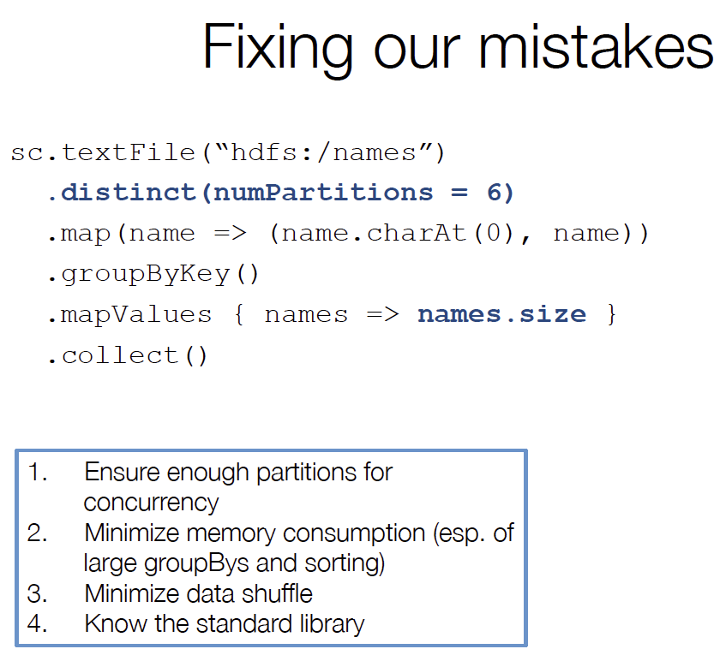

Slide 48
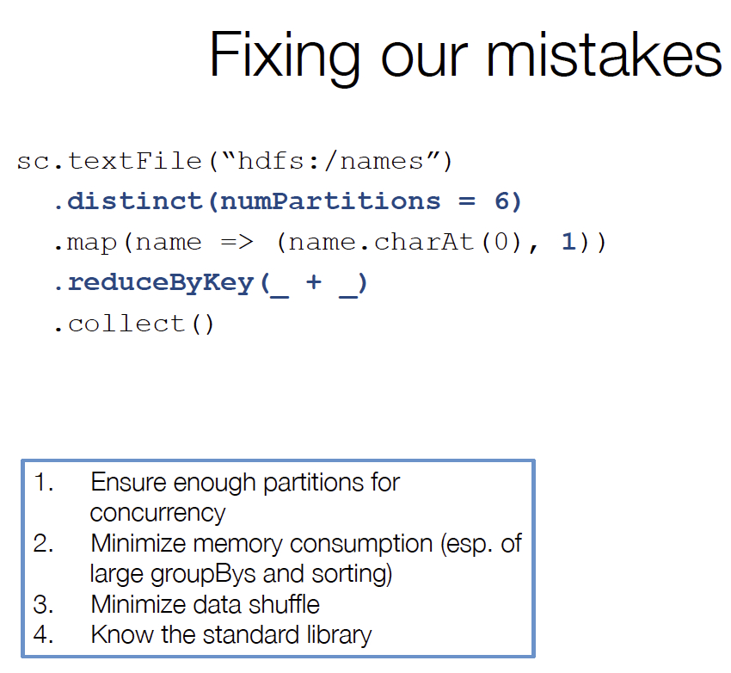

Slide 49
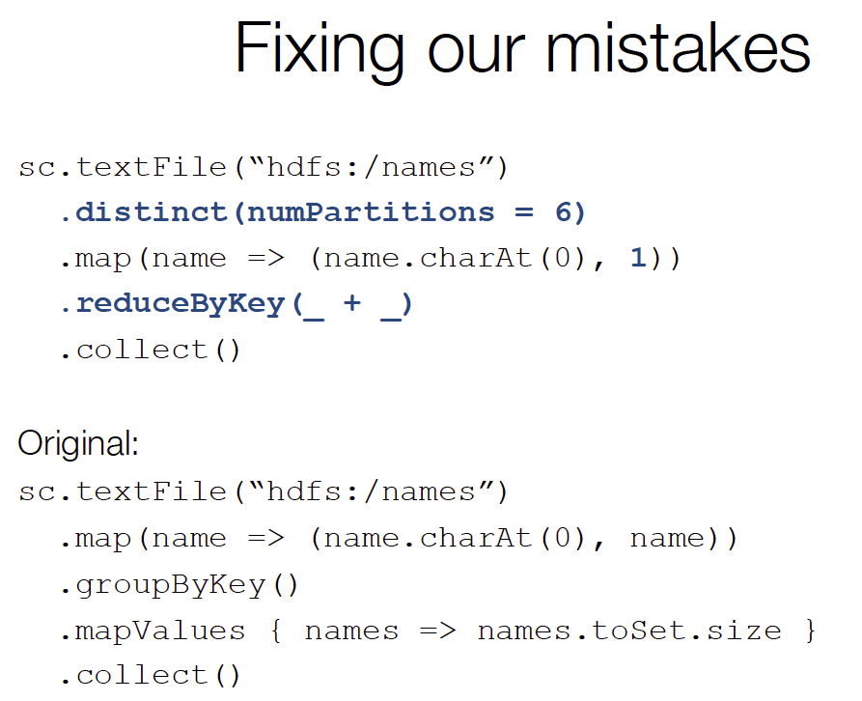

Slide 50
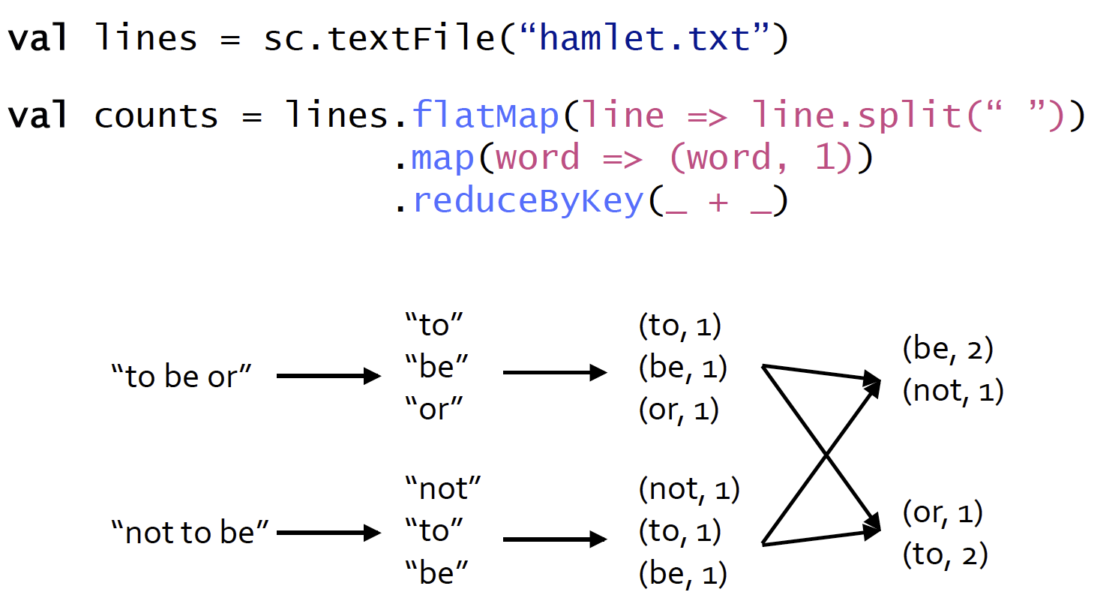
Word Count Example

Slide 51
How do we do topK words?
counts.map( x => (x._2, x._1) ).sortByKey(false).take(20)
or
counts.sortBy(x => x._2, false).take(20)
or
counts.map( {case(word, count) => (count, word)} ).sortByKey(false).take(20)
The above example returns the top 20 words in order of descending count
The map function flips the word and count key-value pairs.
Next we sort the data by the new key of count
Finally we take the top 20 tuples from the final RDD.
It is important to note after each function call above a separate RDD is produced.
  So the counts.map … line creates 3 intermediate temporary RDDs.

Slide 52
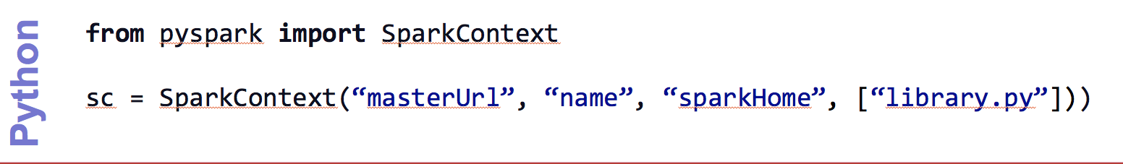
Create a SparkContext
import spark.SparkContext
import spark.SparkContext._
val sc = new SparkContext(“masterUrl”, “name”, “sparkHome”, Seq(“app.jar”))
Scala
Cluster URL, or local / local[N]
App name
Spark install path on cluster
List of JARs with app code (to ship)
import spark.api.java.JavaSparkContext;
JavaSparkContext sc = new JavaSparkContext(
“masterUrl”, “name”, “sparkHome”, new String[] {“app.jar”}));
Java

Slide 53
World Count Complete App: Python
import sys
from pyspark import SparkContext
if __name__ == "__main__":
sc = SparkContext( “local”, “WordCount”, sys.argv[0], None)
lines = sc.textFile(sys.argv[1])
lines.flatMap(lambda s: s.split(“ ”)) \
.map(lambda word: (word, 1)) \
.reduceByKey(lambda x, y: x + y) \
.saveAsTextFile(sys.argv[2])

Slide 54
Word Count Complete App: Scala
import spark.SparkContext
import spark.SparkContext._
object WordCount {
def main(args: Array[String]) {
val sc = new SparkContext(“local”, “WordCount”, args(0), Seq(args(1)))
val lines = sc.textFile(args(2))
lines.flatMap(_.split(“ ”))
.map(word => (word, 1))
.reduceByKey(_ + _)
.saveAsTextFile(args(3))
}
}

Slide 55
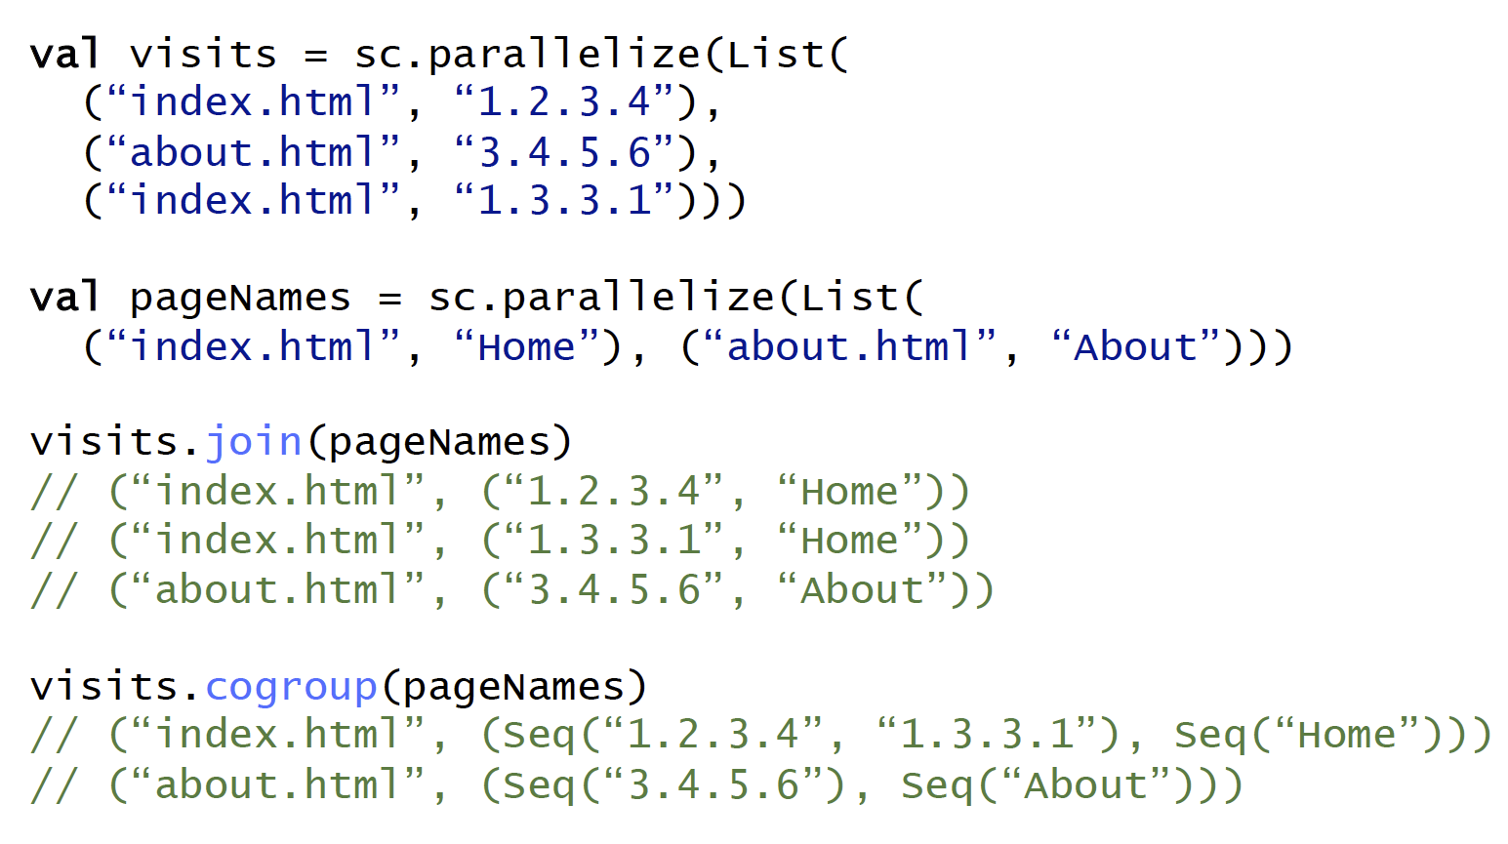
Other Key-Value Operations

Slide 56
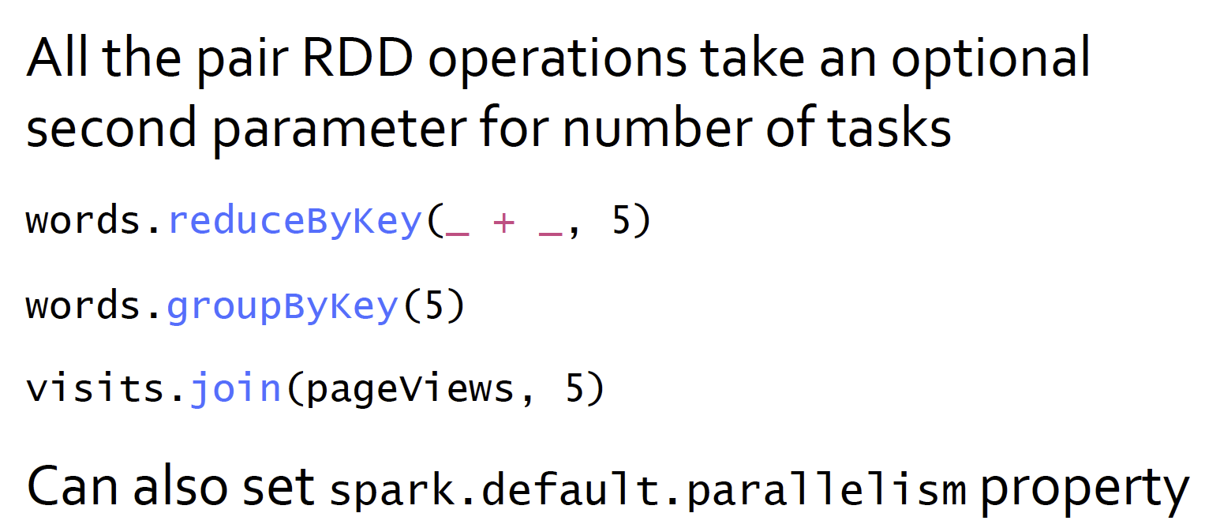
Controlling The Number of Reduce Tasks

Slide 57
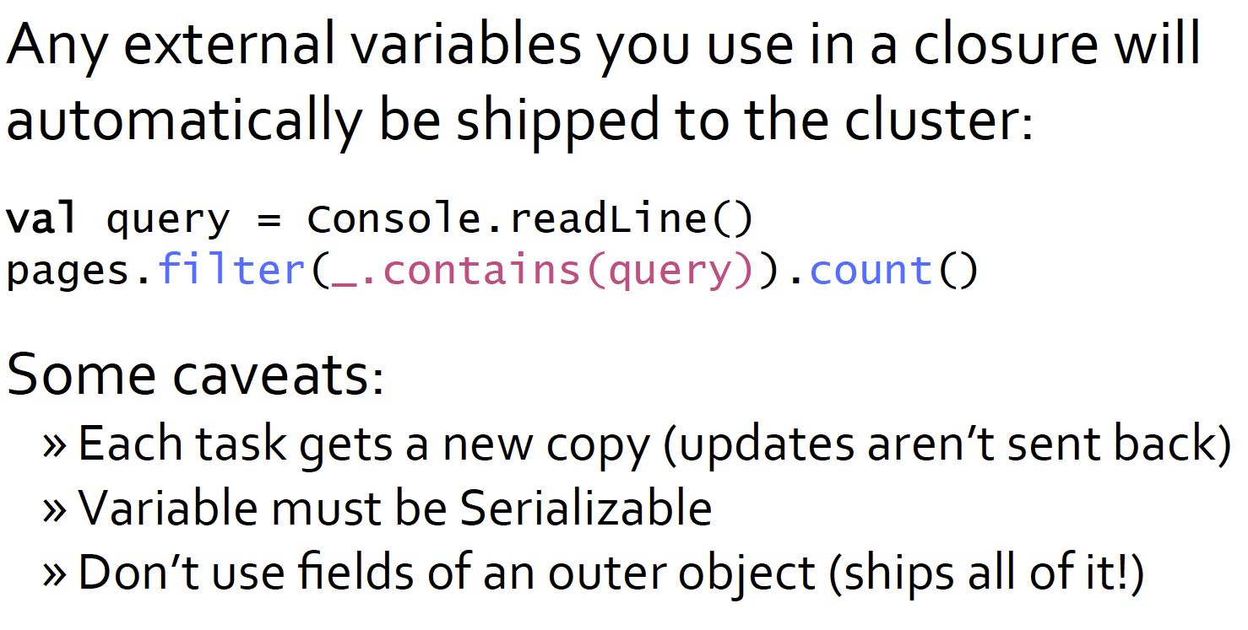
Using Local Variables

Slide 58
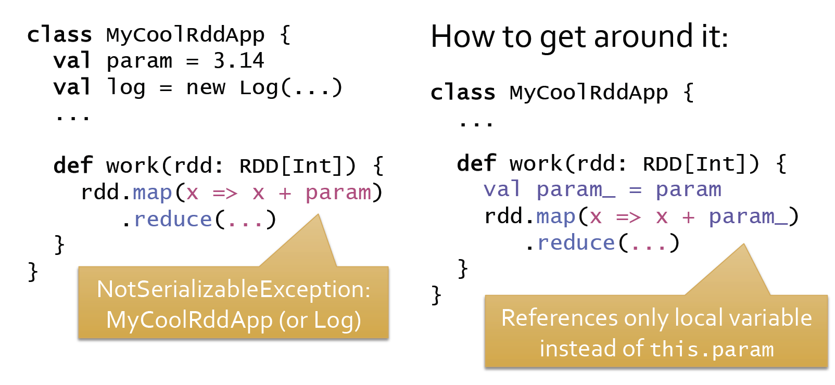
Closure Mishap Example
Even though we are just using the param member of the class MyClassRddApp, the entire object need to be serialized and shipped across the network to all the nodes.
  If some part of the object is not serializable you will get an exception.

Slide 59
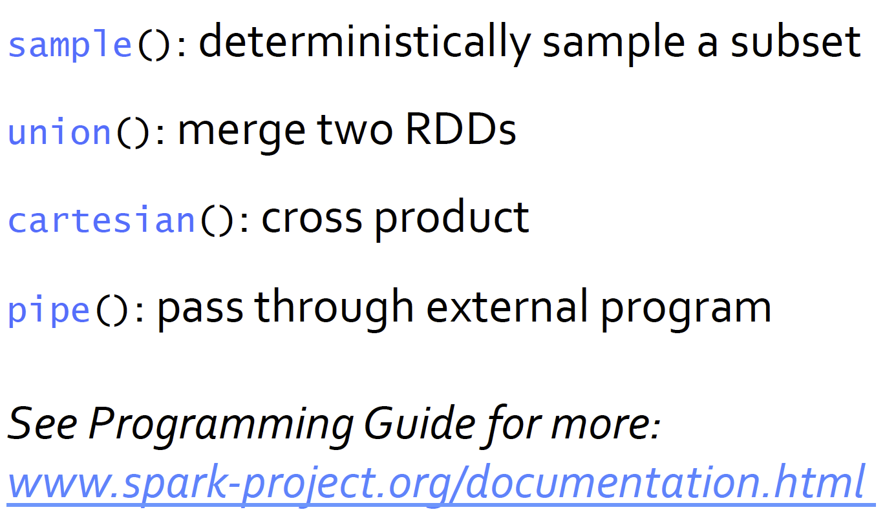
Other RDD Operations

Slide 60
Advanced Spark
Broadcast variables
Please see more in the Appendix if you are interested.

Slide 61
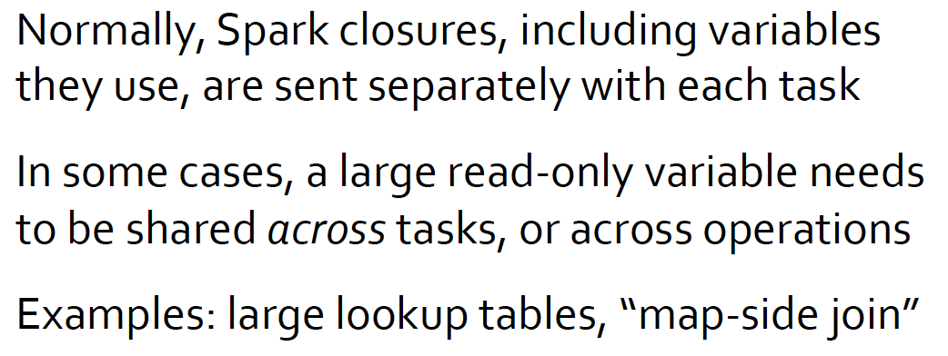
Broadcast Variables

Slide 62
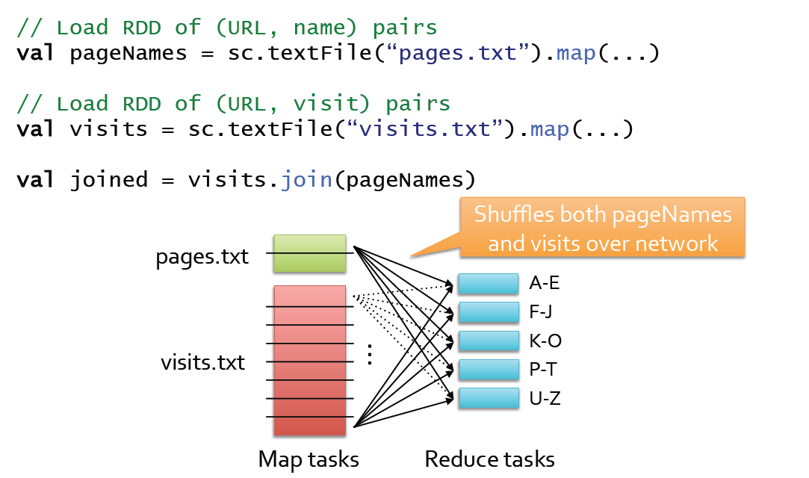
Example: Join

Slide 63
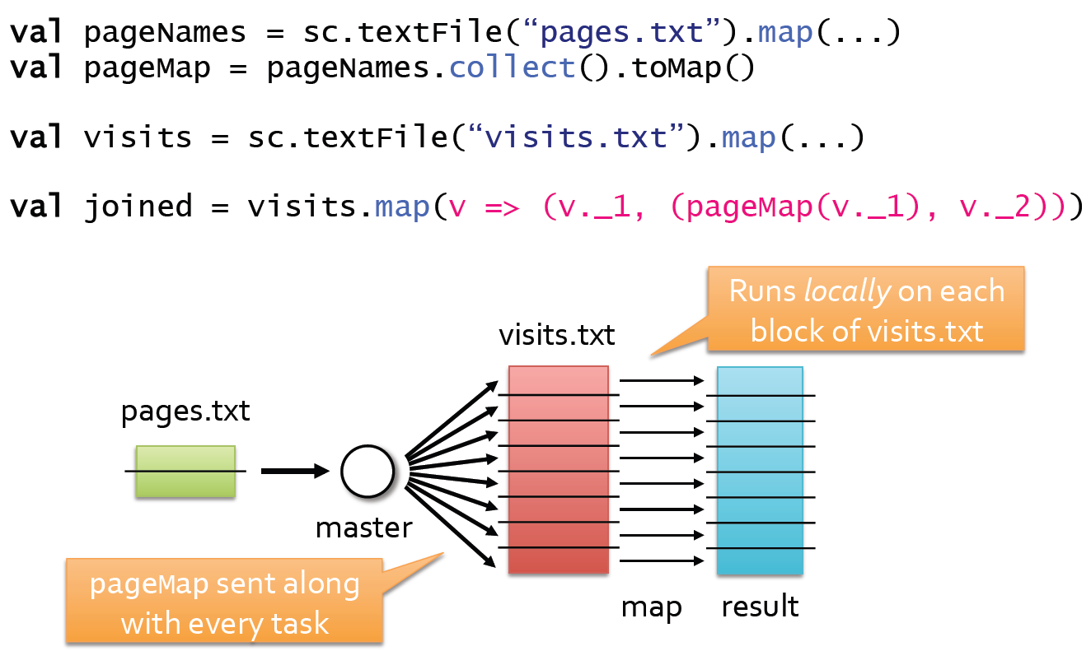
Alternative if one Table is Small
PageMap sent along with every task.
There maybe multiple tasks per node.

Slide 64
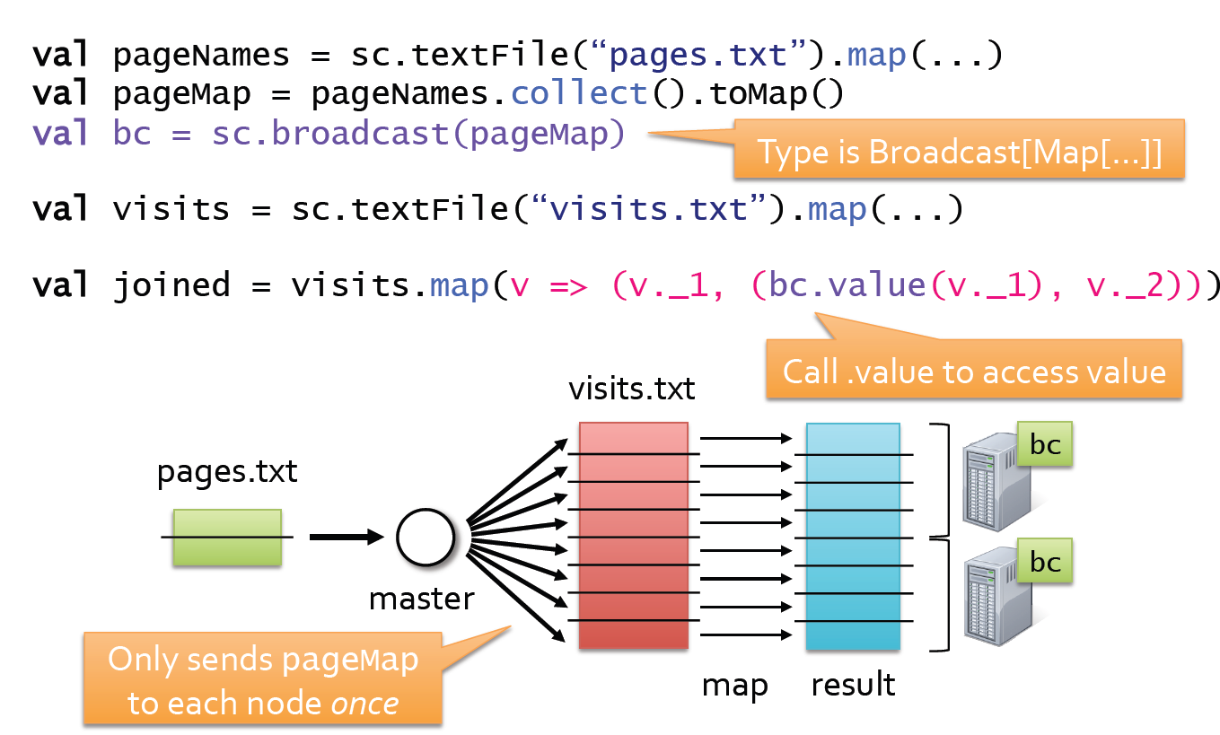
Better Version with Broadcast

Slide 65
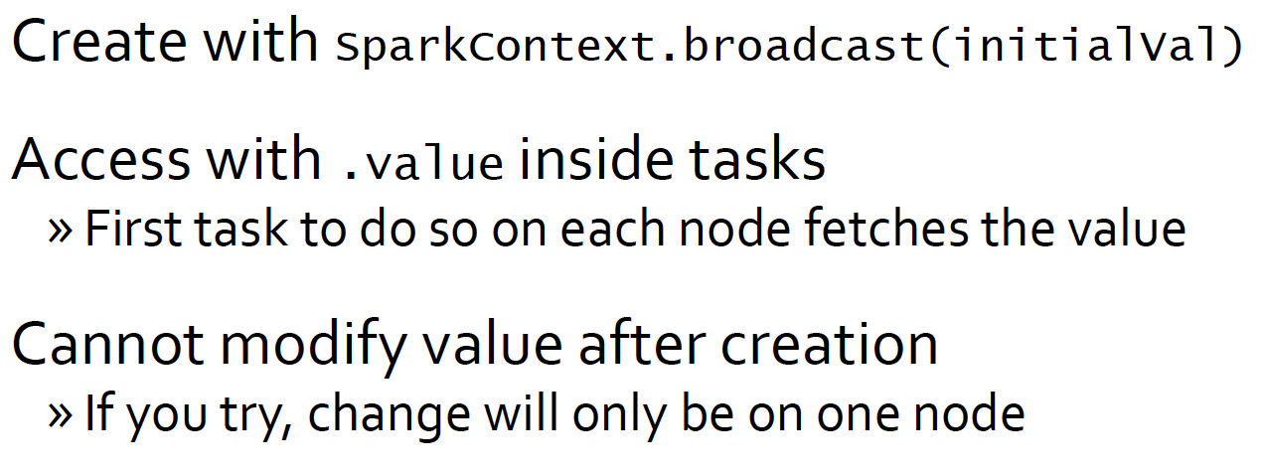
Broadcast Variable Rules

Slide 66
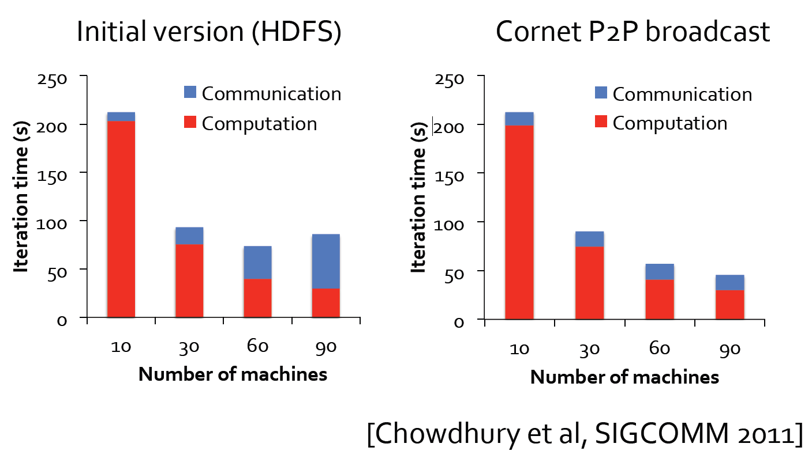
Scaling Up Broadcast

Slide 67
Conclusion
In this lecture we learnt:
  How Spark works
  How to write Spark code

